Slide 1






Nu-2000 Block Diagram (Rev 0.1 & Wiki alpha)
Nu-2000 Main Board
정전류
4-20mA
Input
McMillan U803
12V
DAC
LTC2630
+
UV LED
Driver
SEL[1:0], EN
-
Flow 속도
MFC
(Mass Flow Controller)
LED+/-
STM32F407IG
DAC
LTC2630
4-20mA
Output
UV PD
x 2
3.3V
UV1/2_LVL
DAC
LTC2630
4-20mA
Output
Reserved
UV 농도 data
정전류
DAC
LTC2630
12V
DAC#1
4-20mA
Output
농도 data
PLC
IR LED
Driver
SEL[1:0], EN
DAC#2
LED+/-
GPIO
Parallel
Input (5)
3.3V
+
ADC 4ch.
(AD7682)
SPI#2
IR PD
x 2
IR1/2_LVL
-
Parallel
Output (18)
IR 농도 data
+
-
Main board data 전송
RTD
x 2
+
ADC 2ch.
(MCP3427)
I2C#2
RS-232 #1
PC
-
UART#1
Modbus ASCII
MCU ADC
Test purpose
+
ADC#1
UART#2
RS-232 #2
LCD
RTD
x 2
-
ADC#2
UART#3
RS-232 #3
ADC#3
UART#4
RS-232 #4
PID controller
Leak sensor
Input (8)
GPIO
UART#5
RS-485
Reserved
SDIO
Isolation
EEPROM
(128KB)
DC/DC
12V
Micro
SD Card
DC/DC
3.3V
DC/DC
5V
24Vdc

Slide 2



Nu-2000 Block Diagram (Rev 0.2 & Wiki beta)
12V
Nu-2000 Main Board
UV LED
Driver
SEL[1:0], EN
+
4-20mA
Input
McMillan U803
-
Flow 속도
MFC
(Mass Flow Controller)
UV LD
Driver
EN
STM32F407IG
DAC
LTC2630
4-20mA
Output
UV PD
(Ref & Meas)
3.3V
GPIO
SPI#2
DAC
LTC2630
4-20mA
Output
Reserved
IR LED
Driver
SEL[1:0], EN
buffer
DAC#1
4-20mA
Output
농도 data
PLC
DAC#2
IR LD
Driver
EN
GPIO
Parallel
Input (5)
IR PD
(Ref & Meas)
3.3V
Parallel
Output (18)
I2C repeater
I2C#3
Main board data 전송
RTD
x 2
+
ADC 2ch.
(MCP3427)
I2C#2
RS-232 #1
PC
-
UART#1
Modbus ASCII
MCU ADC
Test purpose
+
ADC#1
UART#2
RS-232 #2
LCD
RTD
x 2
-
ADC#2
UART#3
RS-232 #3
ADC#3
UART#4
RS-232 #4
PID controller
Leak sensor
Input (8)
GPIO
UART#5
RS-485
Reserved
Isolation
EEPROM
(128KB)
SDIO
Micro
SD Card
DC/DC
3.3V
DC/DC
5V
DC/DC
12V
24Vdc
Solenoid valve

Slide 3
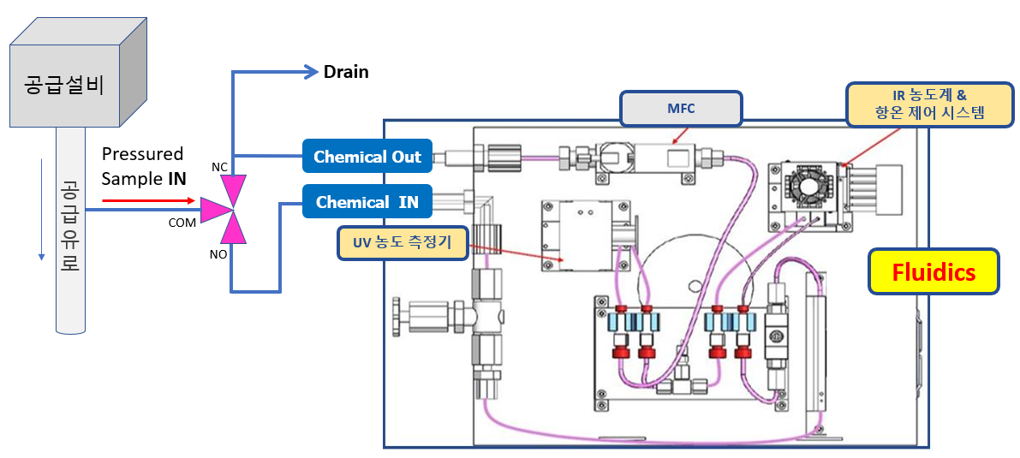

Nu-2000 System Block Diagram
12 V/3.3V
Flow 속도
공정설비
RTD
#1
PLC
Peltier
RTD
#2
Analog Input
RTD
#3
Leak sensor
PID
Controller
Digital In/Out
장비내부
온도
약액
온도
RS-232
4-20mA
In/Out
Nu-2000 Main Board
UV/IR PD Read
GPIO
UV/IR LED on/off
ADC
x 2
RS-232
PC
4-20mA
Out x 2
RS-232
Parallel In/Out
RS-232
AC/DC
220 Vac
24 Vdc

